Slide 1
Digital Portfolio
STUDENT NAME:S.saranya
REGISTER NO AND NMID: asnum222407522
DEPARTMENT: BSc computer science
COLLEGE: Mahalashmi women's College of arts and science

Slide 2
PROJECT TITLE
Digital portfolio

Slide 3


AGENDA
Problem Statement
Project Overview
End Users
Tools and Technologies
Portfolio design and Layout
Features and Functionality
Results and Screenshots
Conclusion
Github Link
3/21/2024 Annual Review

Slide 4

PROBLEM STATEMENT
​The user wants to create a personal portfolio to showcase their skills, projects, and achievements.

Slide 5

PROJECT OVERVIEW
This project is a personal portfolio website built to display the user's information and coding projects. It includes sections for an "About Me" page, a list of "My Projects," and a "Contact Me" form.

Slide 6

WHO ARE THE END USERS?
The primary end users are potential employers, recruiters, and clients who are looking to see examples of the user's work and to learn more about their skills

Slide 7

TOOLS AND TECHNIQUES
The website is built using HTML, CSS, and JavaScript. The CSS code in the screenshot uses a text-align property to center text and sets the width and margins for a contact form.

Slide 8
POTFOLIO DESIGN AND LAYOUT
The design is a simple, modern layout with a clean interface. It uses a blue gradient in the header section and a clean white background for the rest of the page. The content is organized into distinct sections with titles like "About Me," "My Projects," and "Contact Me." The projects are displayed as cards with a button to view more details.
8

Slide 9
FEATURES AND FUNCTIONALITY
The website includes: An About Me section with a brief introduction. A My Projects section showcasing different projects. A Contact Me form with fields for name, email, and a message. The site appears to be responsive since the CSS uses max-width and margin: auto, which helps it look good on different screen sizes.

Slide 10
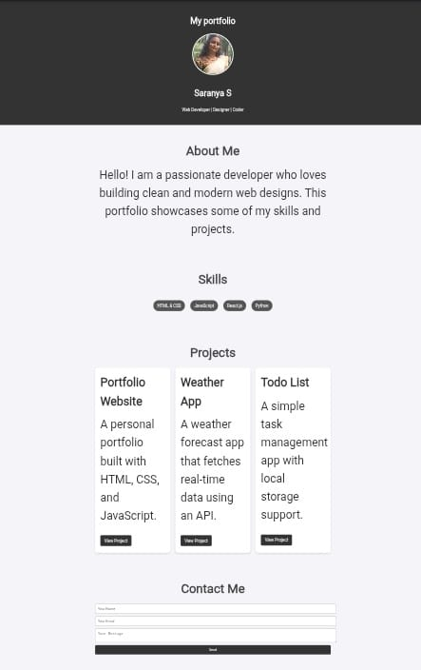

RESULTS AND SCREENSHOTS
3/21/2024 Annual Review
10

Slide 11
CONCLUSION
The portfolio effectively demonstrates the user's front-end development skills in HTML, CSS, and JavaScript. It serves as a great tool for presenting their work to others.
11

